Slide 1
Stock Market Prediction and Portfolio Optimization
Forecasting stock prices using advanced time series model and optimizing a portfolio of 5 stocks using Linear Programming
Submitted By- Ritesh Poudel
International School of Engineering (INSOFE), Bangalore
Batch 25

Slide 2
Description of the data
Downloaded historical quotes of common stocks of 20 different companies trading in NYSE.
Each company is from different sectors.
Data of each company is for 4 years which consists of “Daily Close price, Daily open price, high and low”.
Data is however, not available for non-trading days including weekends.

Slide 3
Pre-processing of Data
Time-series analysis is dependent on consistency of data.
Example of Data: Raytheon
Date | close | Open | High | Low
2013-05-19 | 25.6 | 24.8 | 26.1 | 23.5
2013-05-20 | 26.4 | 25.7 | 26.8 | 25.3
2013-05-21 | 26.3 | 26.4 | 26.5 | 25.9

Slide 4
Pre-processing contd..
Created an empty dataframe with a sequence of dates
Flipped the original dataset so that dates are in ascending order
Merged empty data frame with the original data set
Days for which we don’t have data (non-trading days) is now N/As
Used the previous day closing price and copied to the missing days
Used “ZOO” package with fill the N/A values.

Slide 5
Compound Annual Growth rate (CAGR)
The compound annual growth rate (CAGR) shows the rate of return of an investment over a certain period of time, expressed in annual percentage terms.
Based on CAGR for last 4 years we have calculated top 5 performing companies
Company | CAGR
Facebook | 54.83787
Netflix | 46.35727
Amazon | 37.61508
Tesla | 36.34603
United Health | 28.87828

Slide 6
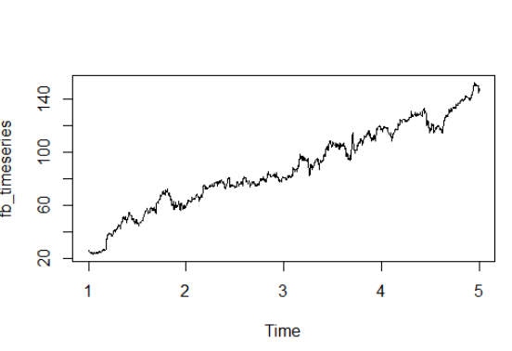
Building Time-Series Model on Best Performing Stock
Created a time series object and plotted a time series Graph
There is a general upward trend on the stock
Models used for forecasting-
Holt-Winter method
AUTO ARIMA and ARIMA
Time-series object for facebook data

Slide 7
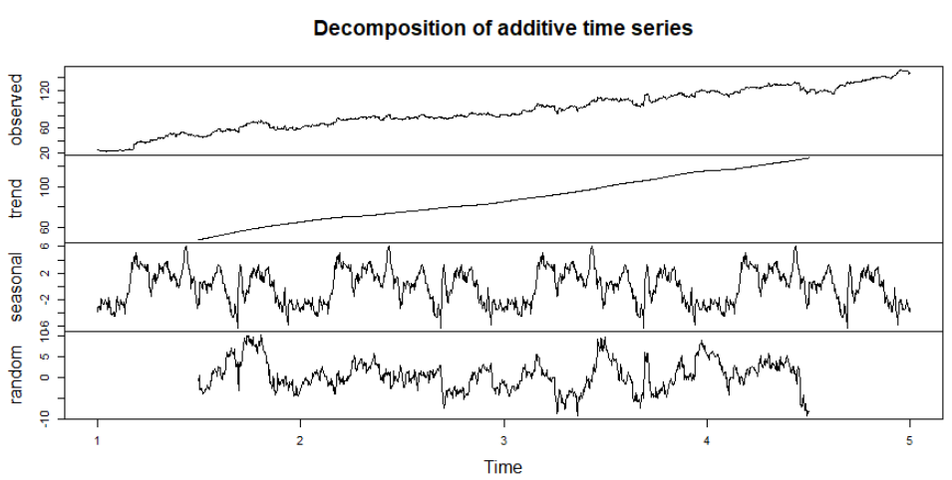
Decomposition of time-series

Slide 8
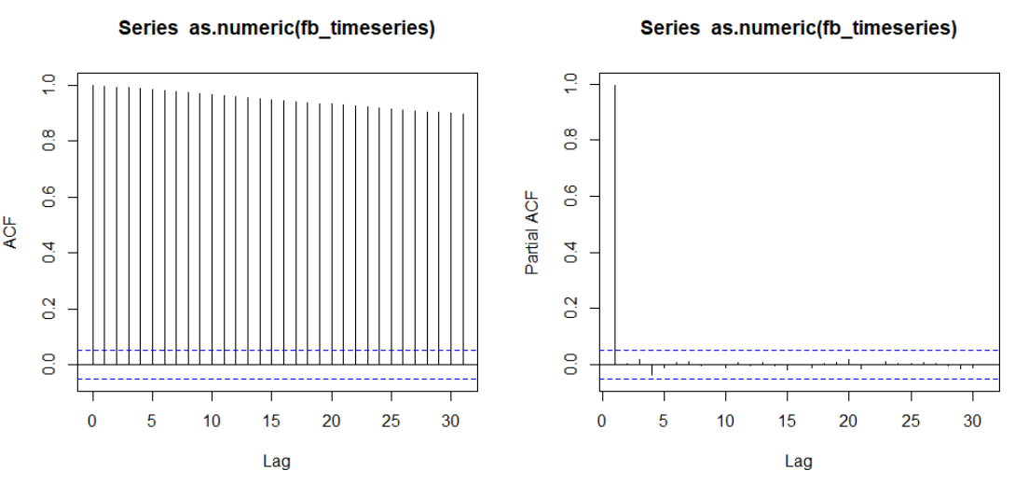
ACF and PACF of the Original data

Slide 9
ACF and PACF of Original Data
The ACF graph shows a clear trend in the data
PACF graph shows a significant spike in the first lag.
Differencing the data once helps removes the gross seasonality from data

Slide 10
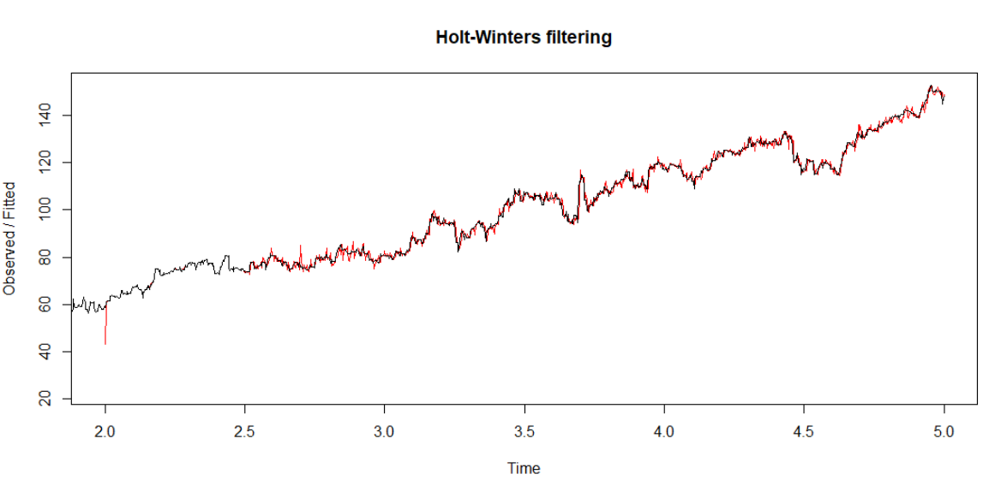
Forecasting using Holts – Winter method Curve fitted graph

Slide 11
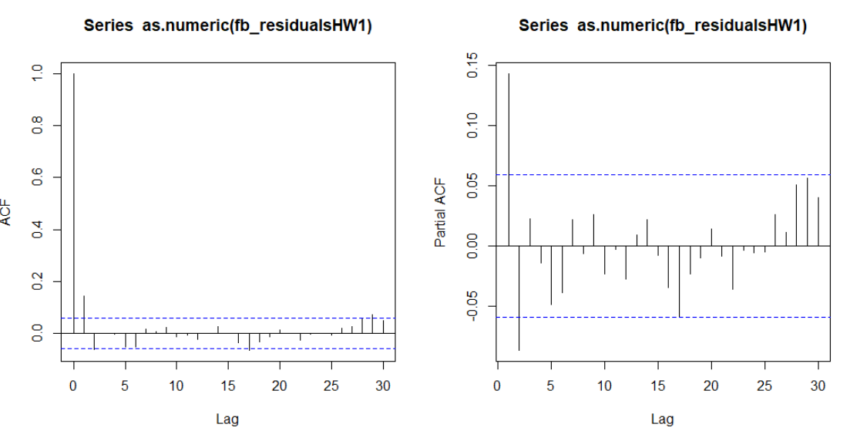
Holts-Winter model residual Analysis
Residuals are uncorrelated with zero mean

Slide 12
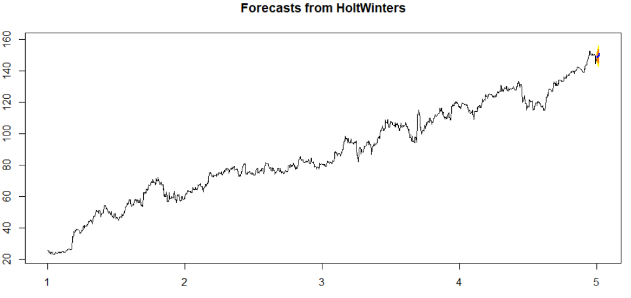
Forecasting Using Holts-Winters
Forecasting of next 7 days closing price.
MAPE VALUE 0.0062

Slide 13
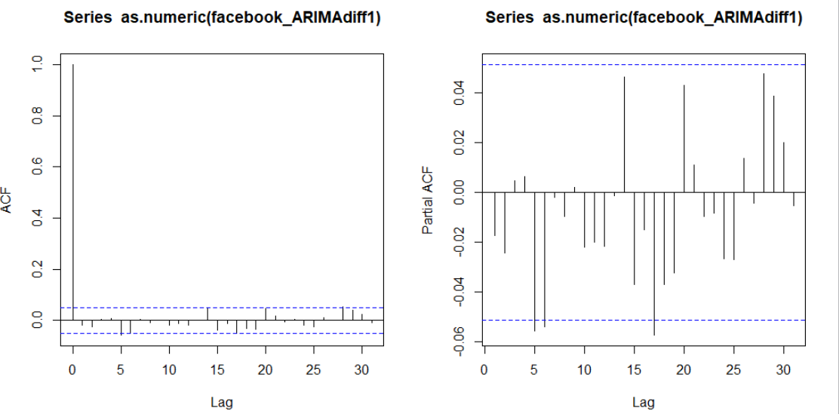
ARIMA Models- ACF and PACF after 1st Diff
Significant spike at zeroth Lag
No significant spike after 1st differencing

Slide 14
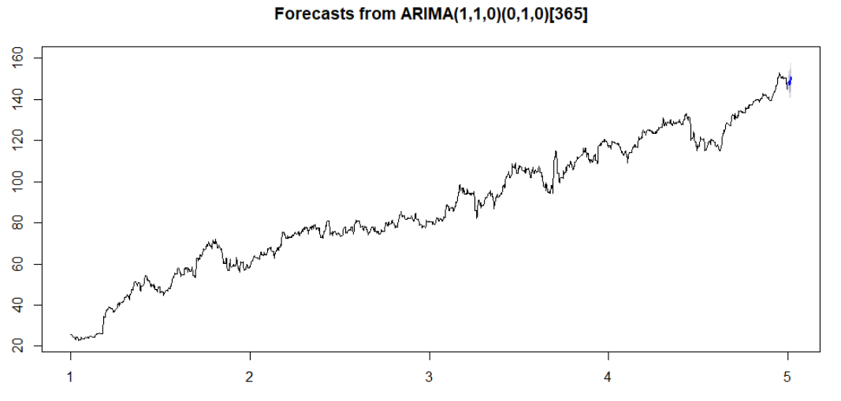
Forecast Using ARIMA Model
Forecasting of next 7 days closing price.
MAPE VALUE 0.0065

Slide 15
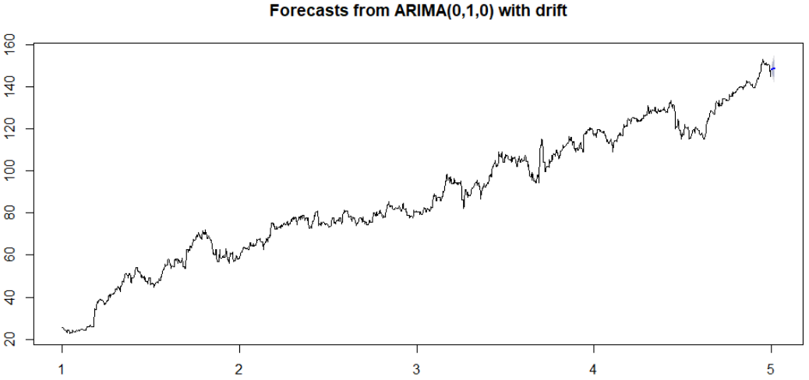
Forecasting Using AUTO ARIMA
Forecasting of next 7 days closing price.
MAPE VALUE 0.0088

Slide 16
Portfolio Optimization Using Linear Programming
Calculated Average rate of return for a month the top 5 performing stocks
Created Objective function based on average rate of return to calculate the optimized amount to be invested in each of my top performing stocks
For this optimization we have assumed uniform risk factor for all the 5 top performing stocks
For the practicality of the model we have assumed below constraints-
Not more than 40% of the amount to be allocated to each of the stocks.
At least 5 % of the total amount to be invested on each stocks

Slide 17
Optimized Investments on stocks
Company | Projected Return rate(%)
Facebook | 4.06
Amazon | 6.74
Netflix | 12.34
Tesla | 1.73
United health | 1.97
Facebook | Amazon | Netflix | Tesla | United health
10000 | 40000 | 40000 | 5000 | 5000

Slide 18
Challenges of algorithmic Trading
Efficient Market Hypothesis –
Developed by Professor Eugene Fama- “Its impossible to beat the market”
Emotions are not captured- Leads to loss important volatility factor which cannot be determined by a machine
Over-optimization – Excessive curve fitting which leads to an unrealistic trading plan in a live market

Slide 19
Development Propects
Interactive data and Reuters – two of the biggest news vendors of the world provides daily news data which can be used to capture market sentiments
Considering risk factor and performing quadratic programming for more realistic optimization

Slide 20

Thank You

